Slide 1

Helwan University - Faculty of Computers & Artificial Intelligence Information Systems Department Module: CS 352 software engineering 2– Spring 2024 SDD for Medical E-Commerce :
Prepared by:
Mariam Mostafa ,
Abdulrahman Maamoun,
Zinab Mohamed ,
Kareem Ayman ,
Ahmed Hesham ,
Shahd Yehia .
Instructor: Dr. Salwa .
Course: CS 352 Software Engineering 2 .
TA: Eng. Abd El Aziz .
Section: Software Engineering 2 .
Date : Wednesday May 8th, 2024 .

Slide 2
The source code for the project can be found here: Or via the QR Code here:
Helwan University - Faculty of Computers & Artificial Intelligence
Information Systems Department Module: CS 352 software engineering 2– Spring 2024
Team Details :
ID | Name | Department
20210521 | Abdulrahman Maamoun Hassan | IS
20210123 | Ahmed Hesham Sayed | IS
20210681 | Kareem Ayman Mohamed | IS
20210929 | Mariam Mostafa Sayed | IS
20210387 | Zinab Mohamed El-Hosiny | IS
20210471 | Shahd Yehia Zakria | IS

Slide 3
Design and Description of Medical E-Commerce
ABSTRACT …………………………………………………………
INTRDUCTION ……………………………………………………
Architecture: ……………………………………………………….
Components: ………………………………………………………
System Overview ………………………………………………….
Design Map …………………………………………………………..
Supporting Material ……………………………………………..
Constraints …………………………………………………………..
User Interface Design …………………………………………..
Backend Design …………………………………………………..
OVERALL DESCRIPTION ……………………………………….
SYSTEM REQUREMENTS ………………………………………
ONLINE SHOPPING APPLICATION …………………………
Data Management ……………………………………………….
Functional / Operational Requirements …….…………
Non-Functional / Operational Requirements ………..
Scalability and Performance Design ………………………
Deployment and Maintenance ……………………………..
Conclusion ……………………………………………………………

Slide 4
ABSTRACT
In today’s fast-changing business environment, it’s extremely important
to be able to respond to client needs in the most effective and timely
manner. If your customers wish to see your business online and have
instant access to your products or services. Online Shopping is a
lifestyle e-commerce web application. This project allows viewing
various products available enables registered users to purchase
desired products instantly using PayPal payment processor (Instant
Pay) and also can place order by using Cash on Delivery (Pay Later)
option.

Slide 5
.
This project provides an easy access to Administrators and Managers to view
orders placed using Pay Later and Instant Pay options. In order to develop an e
-commerce website, a number of Technologies must be studied and understood.
These include multi-tiered architecture, server and client side scripting
techniques, implementation technologies such as spring boot, programming
language (such as java) and relational databases. This is a project with the
objective to develop a basic website where a consumer is provided with a
shopping cart application and also to know about the technologies used to
develop such an application. This document will discuss each of the underlying
technologies to create and implement an medical ecommerce website.

Slide 6
INTRODUCTION
The project Medical E-Commerce System is a complete web-based application designed on Vue.js and spring boot technology using Visual Studio Software. The main aim of the project is to develop a system in which is to provide a convenient, accessible, and efficient platform for the purchase and sale of medical products and services. Some key objectives and benefits include:
Accessibility: Online medical e-commerce makes it easier for individuals to access a wide range of medical products and services from the comfort of their homes or offices, regardless of their geographical location. This accessibility is particularly beneficial for individuals with mobility issues or those residing in remote areas with limited access to physical medical stores.
Convenience: By enabling users to browse, compare, and purchase medical products and services online, e-commerce platforms offer a level of convenience

Slide 7
that traditional brick-and-mortar stores may not provide. Users can shop at any time of the day or night, avoiding the need to travel to physical stores and wait in long queues.
Product Variety: Online medical e-commerce platforms typically offer a diverse range of medical products and services, including over-the-counter medications, prescription drugs, medical devices, health supplements, personal care products, and wellness services. This extensive product variety allows users to find and purchase the specific items they need without limitations.
Price Transparency and Competition: E-commerce platforms foster price transparency by allowing users to compare prices and reviews from multiple sellers, facilitating informed purchasing decisions. Additionally, the competitive nature of online markets often results in competitive pricing and promotional offers, providing users with cost-effective options for their medical needs.
Privacy and Discretion: Online medical e-commerce respects user privacy and

Slide 8
discretion by allowing individuals to browse and purchase medical products and
services discreetly, without the need for face-to-face interactions with healthcare
providers or pharmacists. This can be particularly important for individuals seeking sensitive products or treatments.
Information and Education: E-commerce platforms often provide valuable information and educational resources related to medical products, conditions, treatments, and wellness practices. This educational content empowers users to make informed decisions about their health and well-being, promoting self-care and preventive healthcare practices.
Contribution to Healthcare Accessibility: Online medical e-commerce plays a role in improving overall healthcare accessibility by complementing traditional healthcare delivery models. It facilitates access to essential medical supplies, particularly for individuals with chronic conditions or special healthcare needs, and may serve as a valuable resource during emergencies or public health crises.

Slide 9
Architecture:
Overview: The system will adopt a client-server architecture where the client-side application (web browser) interacts with the server-side application via HTTP requests. The server-side application will manage the business logic and interact with the database to store and retrieve data.
Components:
Frontend: Developed using modern web technologies (HTML, CSS, JavaScript), with frameworks Vue.js for dynamic user interfaces.
Backend: Implemented using Java Spring Boot, responsible for handling HTTP requests, processing business logic, and serving data to the frontend.
Database: Utilizes a relational database management system (MySQL) for storing structured data related to users, products, orders, etc.
Interactions: The frontend communicates with the backend through RESTful APIs, sending HTTP requests (GET, POST, PUT, DELETE) to perform CRUD (Create, Read, Update, Delete) operations on resources.

Slide 10
System Overview
The sales process for medical products needs an application to manage it Their works. This application should be web-based and able to accommodate various Business functions to handle daily operations. Among the requirements are the following:
Web Based Application
Database driven (SQL)
Secure
Facilitate Back Office Operations:
Supply Inventory
Product Inventory
Shipping
Receiving
Accounts Payable
Scheduling

Slide 11
Design Map
Software Methodology
The overall project requirements will be clearly defined in the outset of the project, with dated Gantt chart and clear project responsibilities. Since the customer has no need to review programming technique or progress, a design methodology of the type “Waterfall” will be used. The waterfall methodology allows the project to be developed and managed when segmented into a hierarchy of phases, activities, tasks and steps. This model lends itself well to the Gantt chart, which will help monitor the development process, and increase the likelihood of an on time delivery of the source code. The development process will be broken into 5 Phases:
Design Code Test Bug Fixes Documentation
Design Phase
The design phase consists of producing this document, which includes the software design requirements. These requirements will be reviewed by the primary contact for the final deliverable, and once approved, will continue to the “code” phase.

Slide 12
Code phase
The code phase involves application development, based on the design
specifications contained in this document. This phase is further subdivided into
three distinct portions: API Interface, Primary Interface, and Database Design.
Test phase
The testing phase will document all user processes, and verify their functionality. The customer will be involved in this phase to ensure the system is functioning as expected. Additionally, “Bugzilla” will be utilize to track and close any encountered issues.
Bug Fixes
During the testing phase, the bug fix phase will run concurrently, as development repairs any bugs, and testing verifies bug fixes.
Documentation
will include source, and user documentation, as well as known issues and limitations.

Slide 13
Supporting Material
FEDEX and UPS Integration The Web API for FedEx and UPS should be utilized for shipping / receiving functions, as well as automatic payment systems. These documents can be found at: http://www.fedex.com/us/solutions/shipapi/sample_code.html?link=4 http://www.programmableweb.com/api/UPS
Payment systems will be handled using Google’s Checkout service to process accounts receivable, payable, and retail checkout. The API can be found here: https://www.google.com/accounts/ServiceLogin?service=sierra&continue=https%3A%2 F%2Fcheckout.google.com%2F%3Fgsessionid%3DnVbqyZXZioQ%26upgrade%3Dtrue &hl=en_US&nui=1&ltmpl=default
Constraints
Software
Product Classification: Medical products are classified into different categories based on factors such as intended use, risk level. The software must support accurate classification and categorization of products to ensure appropriate listing, labeling, and distribution.

Slide 14
Product Information Management: The software must support the storage and retrieval of comprehensive product data, including descriptions, specifications, indications, contraindications, precautions, and usage instructions.
Inventory Management: Effective inventory management is essential to ensure the availability of medical products and prevent stockouts or overstock situations.
Quality Assurance: The software must implement quality assurance measures such as product authentication, batch tracking, expiration date management, and supplier verification to mitigate the risk of counterfeit or substandard products.
Hardware
Testing and performance monitoring should be baselined on this configuration. The server will have up to two processors, and 2 GB of RAM.
User Interface Design
Input Field for Adding New products (Admin)
Buttons for Editing and Deleting products (Admin)
Buttons for Editing and Deleting the chosen products

Slide 15
Backend Design
application is designed as a RESTful API to facilitate communication between the client-side interface and the server-side logic.
The following endpoints and functionalities are defined:
GET /tasks: Retrieves all tasks from the database and returns them as JSON objects to the client.
POST /tasks: Receives a new task object from the client, validates it, and inserts it into the database. Returns the newly created task object with a unique identifier.
PUT /tasks/:id: Accepts an updated task object with the specified identifier from the client, validates it, and updates the corresponding task in the database. Returns the updated task object.
DELETE /tasks/:id: Deletes the task with the specified identifier from the database. Returns a success message upon successful deletion.

Slide 16
OVERALL DESCRIPTION
DESCRIPTION:-
Any member can register and view available products.
Any member can search for products
There are three roles available: Visitor, User and Admin.
Guest can view available products.
Customer can view and purchase products.
An Admin has some extra privilege including all privilege of Visitor and User.
- Admin can add products, edit product information and add/remove product.
- Admin can add User, edit User information and can remove User.
- Admin can ship order to User based on order placed by sending confirmation mail.

Slide 17
Using the code:
Attach the database in your “XAMPP Server ".
Run the application on Microsoft Visual Studio as web site.
Locate the database.
Web Pages details:
Home Page
About Us Page
Blog Page
Shop Page
Contact Us Page
Admin Page
Login Page
Your Cart Page

Slide 18
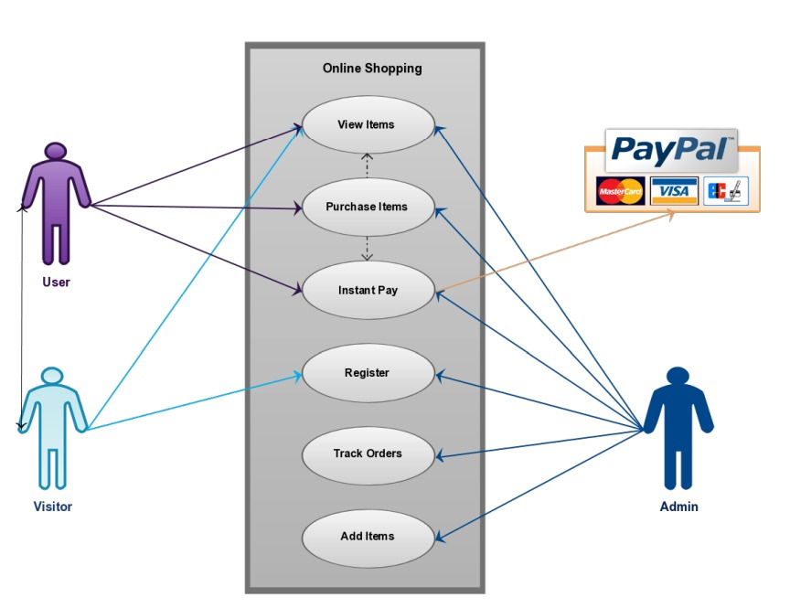
SYSTEM REQUREMENTS
USE-CASE DIAGRAM:

Slide 19
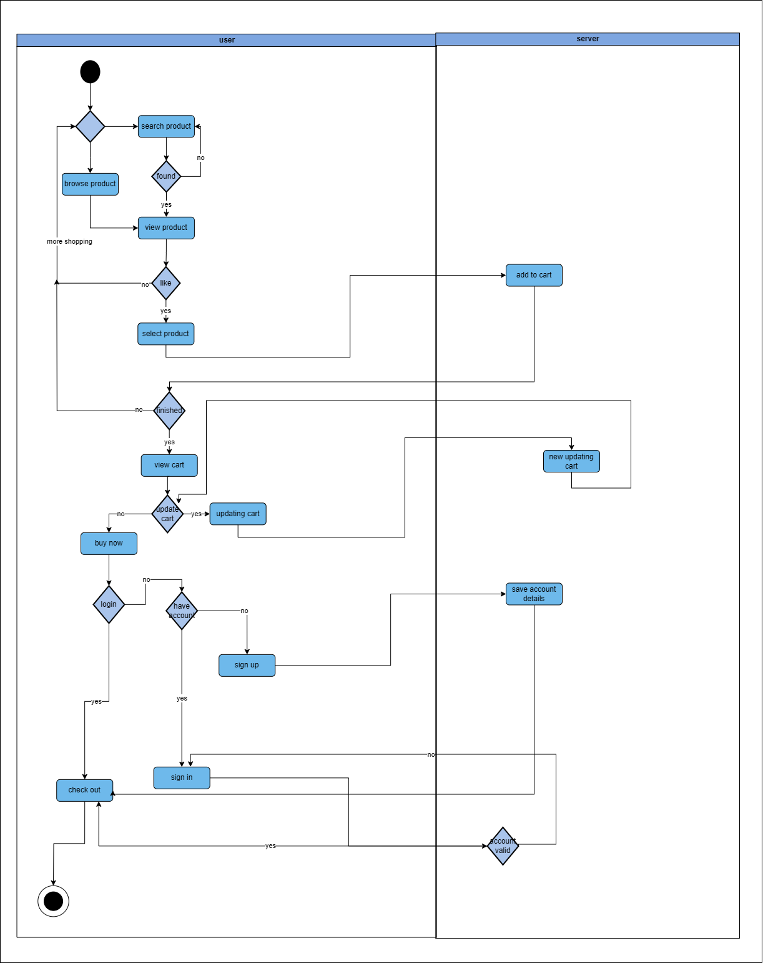
ACTIVITY DIAGRAM :

Slide 20
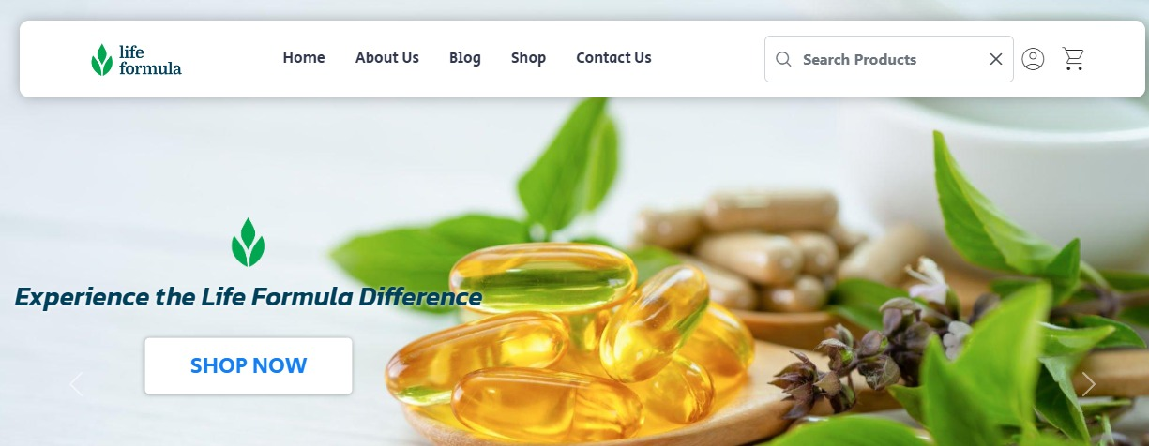
MEDICAL ONLINE SHOPPING APPLICATION
Anyone can view Online Shopping portal and available products, but every user must login by
his/her Username and password in order to purchase or order products. Unregistered members
can register by navigating to registration page. Only Admin will have access to modify roles, by
default developer can only be an ‘Admin’. Once user register site, his default role will be ‘User’.
HOMEPAGE: The Home Screen will consist of screen were one can browse through the products which we have on our website

Slide 21
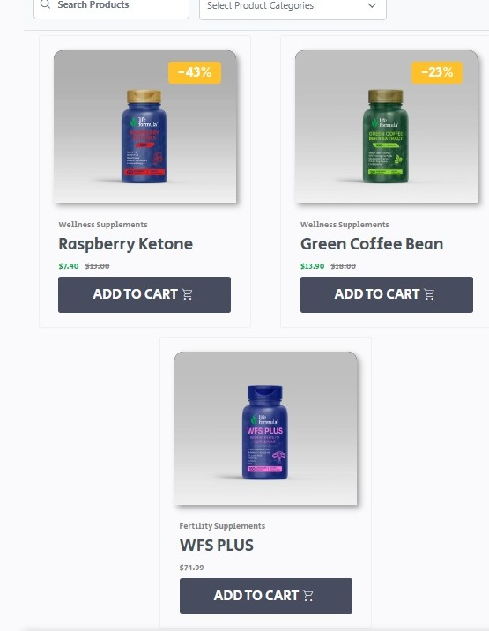
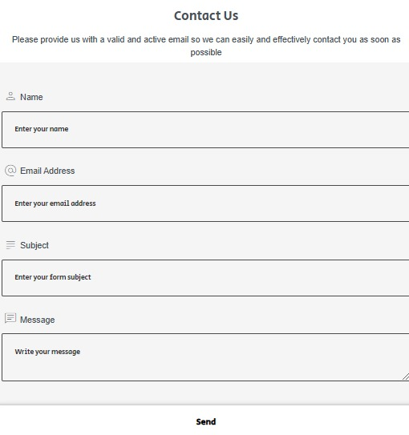
SHOP PAGE (PRODUCTS): This page consists of product details. This page appears same for both visitors and users.
Contact Us Page: Visitors and Registered users can contact website owners or administrators from here

Slide 22
ABOUT US PAGE: This page describes about website and owners .
REGISTER PAGE: New users can register here.
LOGIN PAGE: Login page for both users and administrators.
Admin Page: Only difference you see in this page is Role: Admin. User and Admin role will be checked once the page was login and Session [“role”] will be either Admin or User. If credentials belong to Admin then role will be Admin and if credentials belong to User then role will be User.
ORDER VIEW FOR USER: Once users order item they are able to see ordered products and grand total.
PAYPAL FOR PAYMENT: Once users orders products they are redirected to payment page.

Slide 23
Data Management
This database consists of
Users:
User and Admin information is added to database with Unique ID based
on their roles.
Shop:
Complete products information is stored in this table.
Orders:
Customer ordered products, status and delivery information is stored in
this table.
Data Objects
User: ID, UserName, Password, Email, Role
Shopping: ID, Product, Product ID, Cost, Category, Image, Description
Orders: ID, Client, Product, Quantity, Price, Date

Slide 24
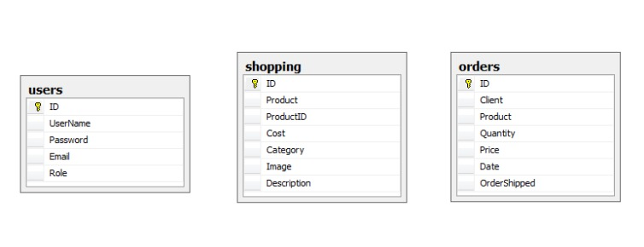
Database Table Diagram

Slide 25
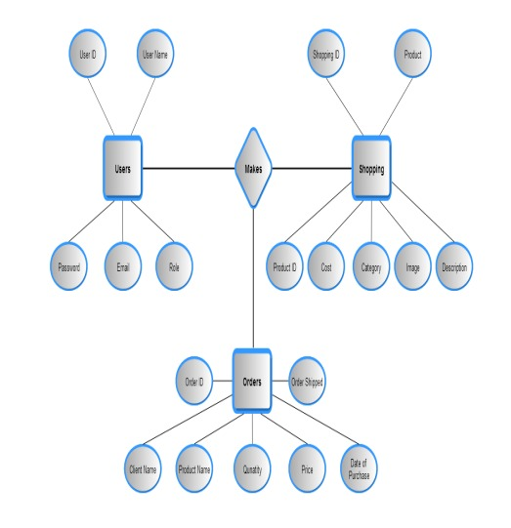
Relationships:

Slide 26
Functional / Operational Requirements
User Registration and Authentication
- Users should be able to register accounts with personal information.
- Authentication mechanisms should ensure secure access to user accounts.
Product Catalog
- Display a catalog of medical products with detailed descriptions.
- Categorize products for easy navigation.
- Allow users to search and filter products by category, brand, price, etc.
Product Details
- Provide detailed information about each product, including price, availability, specifications, and images.

Slide 27
Shopping Cart
- Allow users to add products to a shopping cart.
- Enable users to view, modify, and remove items from the cart.
- Calculate the total price including taxes and shipping costs.
Checkout Process
- Guide users through a secure checkout process.
- Collect shipping and billing information.
- Support various payment methods, such as credit/debit cards, PayPal, etc.
- Provide order confirmation and receipt.

Slide 28
Non-Functional / Operational Requirements
Security
Pages of the website must be access in the way they were intended to be accessed.
Included files shall not be accessed outside of their parent file.
Administrator can only perform administrative task on pages they are privileged to
access. Customers will not be allowed to access the administrator pages
Threat Analysis: A thorough threat analysis will be conducted to identify potential security vulnerabilities and threats to the system.
Defense Mechanisms: Security measures such as input validation, output encoding, parameterized queries, and prepared statements will be implemented to mitigate common security risks such as SQL injection, cross-site scripting (XSS), and cross-site request forgery (CSRF).
Data Encryption: Sensitive data such as user passwords and payment information will be encrypted using industry-standard encryption algorithms to protect against unauthorized access.

Slide 29
HTTPS Encryption: Communication between the client-side interface and the server-side API is encrypted using HTTPS protocol to ensure data confidentiality and integrity, mitigating the risk of eavesdropping and man-in-the-middle attacks.
Authentication and Authorization: To differentiate between roles between admin and users
Efficiency and Maintainability
Page loads should be returned and formatted in a timely fashion depending on the request being made. ➢ Administrators will have the ability to edit the aspects of the order forms, product descriptions, prices and website directly
Scalability and Performance Design
The application is designed to handle multiple concurrent users.
Deployment and Maintenance
The application can be deployed on a cloud / Docker platform. Maintenance involves regular updates to fix bugs and add new features.

Slide 30
Performance
Ensure fast loading times for product pages and checkout process. - Handle concurrent user sessions and transactions efficiently. - Optimize database queries and server responses to minimize latency.
Scalability
Design the application to handle increased traffic and growing product inventory. - Implement scalable infrastructure and cloud services to support future growth.
Reliability
Minimize downtime and ensure high availability of the application. - Implement backup and disaster recovery mechanisms to prevent data loss.
Usability
Design an intuitive user interface that is easy to navigate and understand. - Ensure compatibility with various devices and screen sizes (responsive design). - Provide helpful tooltips, error messages, and guidance throughout the application
Accuracy
The system should accurately provide real time information taking into consideration various concurrency issues. The system shall provide 100% access reliability.

Slide 31
Conclusion
The Internet has become a major resource in modern business, thus electronic shopping has gained significance not only from the entrepreneur’s but also from the customer’s point of view. For the entrepreneur, electronic shopping generates new business opportunities and for the customer, it makes comparative shopping possible. As per a survey, most consumers of online stores are impulsive and usually make a decision to stay on a site within the first few seconds. “Website design is like a shop interior. If the shop looks poor or like hundreds of other shops the customer is most likely to skip to the other site. Hence we have designed the project to provide the user with easy navigation, retrieval of data and necessary feedback as much as possible. In this project. To implement this as a web application we used Spring boot as the Technology. Spring boot has several advantages such as enhanced performance, scalability, built-in security and simplicity.
To build any web application using Spring boot we need a programming language such as java. Java was the language used to build this application.
MySQL was used as back-end database since it is one of the most popular databases, and it provides fast data access, easy installation and simplicity.

Slide 32
A good design must be accompanied with user-friendly application logic. It should be convenient for the customer to view the contents of their cart and to be able to remove or add items to their cart. The shopping cart application described in this project provides a number of features that are designed to make the customer more comfortable.
This project helps in understanding the creation of an interactive web page and the
technologies used to implement it. The building of the project has given me a precise
knowledge about how Spring boot is used to develop a website, how it connects to the database
to access the data and how the data and web pages are modified to provide the user with a
application.

